Slide 1
Capstone Project Progress Report
Michael Desir

Slide 2
Data
Primary Dataset
Coverage Period
POL – Use of Force Details from the Montgomery County Police Department. Refreshed daily, this dataset captures every instance of force used by officers on subjects and vice versa for a granular, real-time record of use-of-force events.
2022 through March 2026: four years of longitudinal incident data enabling trend analysis across time, district, and demographics.
Supporting Datasets
MCPD Crime Dataset — extra information about the associated crime
Police Dispatched Incidents — dispatch provides location data, plus the number of officers involved

Slide 3
RESEARCH GOALS
Three Core Questions
1
2
3
Race & Use of Force
Trends Over Time
Beyond Race
Are racial groups disproportionately represented in force incidents? How does force type and officer count vary by subject race?
How have use-of-force incidents evolved from 2022 to 2026, both countywide and by police district?
What other factors — mental illness, substance use, geography — shape the type and severity of force used?

Slide 4







Slide 5
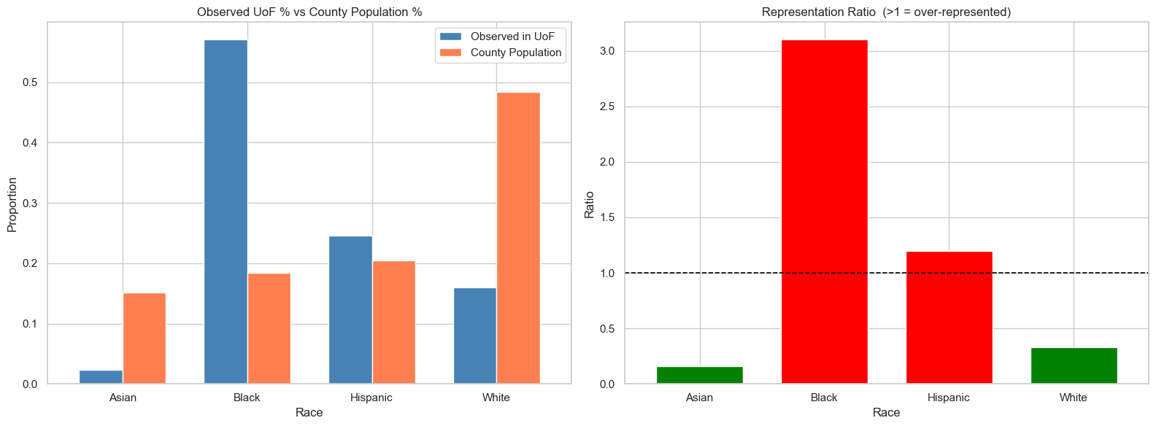

Slide 6
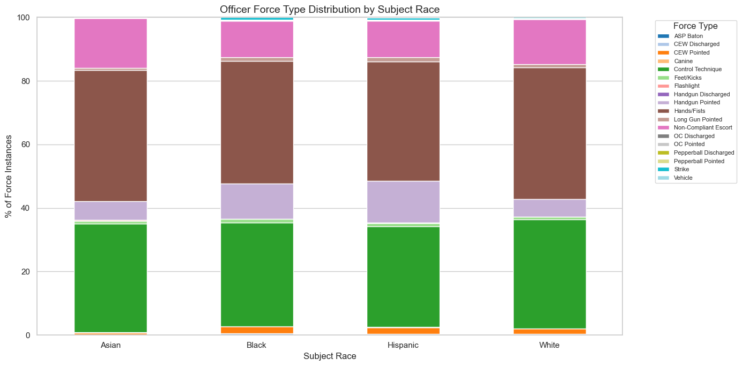

Slide 7
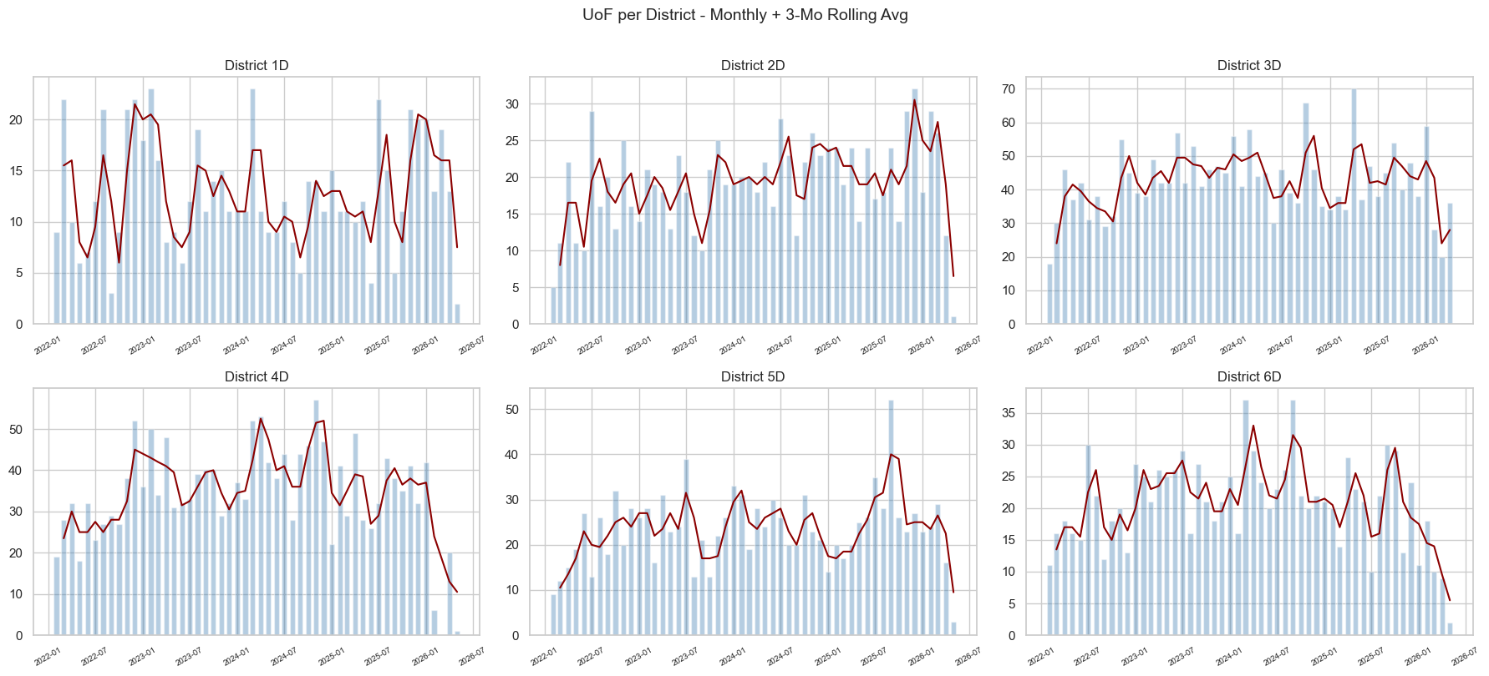
Time Series #1

Slide 8
RESEARCH GOALS
What’s Next?
1
2
3
Statistical Modeling
Mapping
Beyond Race
Chi-squared on force type vs subject race, Kruskal-Wallis on number of officers involved vs subject race
Infrastructure is finally in place, now ready to map out concentrations of incidents in granular detail
Multinomial logistic regression for factors outside of race that affect use of force outcomes

